Slide 1

ARIVUTHENDRAL K
Emotion Recognization using smart phones
3/21/2024 Annual Review

Slide 2
Emotion recognization using smartphones
Emotion Recognition Using Smartphone Technology is an innovative solution that harnesses the power of machine learning to automatically detect and interpret emotional cues from individuals captured in images. With a primary focus on enhancing interpersonal dynamics and communication, this project introduces a convenient tool for analyzing emotional states in real-time.
By offering instant emotion recognition capabilities through smartphones, it aids individuals and organizations in understanding and responding to emotional signals effectively. This technology promotes improved social interactions, empathy, and mental well-being by providing insights into emotional nuances, ultimately fostering healthier and more meaningful connections in various social settings
3/21/2024 Annual Review

Slide 3


AGENDA
PROJECT TITLE
AGENDA
PROBLEM STATEMENT
PROJECT OVERVIEW
WHO ARE THE END USER
YOUR SOLUTION AND VALUE PROPOSITION
THE WOW IN YOUR SOLUTION
MODELLING
RESULTS
3/21/2024 Annual Review

Slide 4

PROBLEM STATEMENT
In many social interactions, accurately gauging emotional cues can be challenging, especially in fast-paced or crowded environments where subtleties can easily be missed. This issue is particularly pertinent in situations where understanding emotions is crucial for effective communication and relationship-building. Our project aims to tackle this challenge by leveraging smartphone technology to develop an automated solution using machine learning techniques for emotion recognition in real-time. By providing a reliable and convenient method for detecting and interpreting emotional signals through smartphones, our solution aims to enhance interpersonal interactions and facilitate better communication, ultimately fostering stronger connections and improving social dynamics.
3/21/2024 Annual Review

Slide 5

PROJECT OVERVIEW
Our project focuses on creating an Emotion Recognition system using machine learning technology. The goal is to develop an automated solution capable of identifying and interpreting emotional expressions in images captured through smartphones. Even beyond the pandemic era, understanding emotional cues remains crucial for various social and professional contexts. Our solution aims to meet this ongoing need by providing an efficient tool for analyzing emotions in real-time.
By leveraging advanced machine learning algorithms, we aim to build a system that can accurately recognize a range of emotions, aiding individuals and organizations in better understanding and responding to emotional signals. This technology will contribute to fostering empathy, improving communication, and enhancing overall emotional well-being in diverse social environments.
3/21/2024 Annual Review

Slide 6

WHO ARE THE END USERS?
Businesses
Educational Institutions
Public transportation operators
Healthcare providers
Government agencies
These stakeholders may utilize the system to:
Monitor and understand emotional states among employees, students, passengers, patients, and the general public.
Enhance mental well-being and foster positive interactions within their respective environments.
Promote empathy and effective communication in public spaces and organizational contexts.
3/21/2024 Annual Review

Slide 7

YOUR SOLUTION AND ITS VALUE PROPOSITION
Automated Detection: Our system, using video and microphone input, swiftly recognizes emotional expressions.
Efficiency & Accuracy: Saves time and resources by automating recognition tasks with high precision.
Scalable & Customizable: Easily adaptable to different setups and adjustable to user preferences.
Enhanced Understanding: Helps users grasp emotional cues for improved communication and relationships.
3/21/2024 Annual Review

Slide 8

THE WOW IN YOUR SOLUTION
Real-Time Detection: Our system delivers instant recognition of emotional cues in video and audio inputs, providing immediate insights to users.
High Accuracy: Employing cutting-edge machine learning techniques, our system achieves accurate emotional recognition, reducing inaccuracies and false signals
User-Friendly Interface: Crafted for ease of use, our system features an intuitive interface that is simple to navigate, ensuring accessibility for users of varying expertise levels.
Scalability: Built to accommodate various environments and user needs, our system can scale from small businesses to large-scale public spaces without compromising performance.
Customizable Solutions: With configurable parameters and settings, our system can be tailored to suit the unique requirements of different users and applications.
3/21/2024 Annual Review
8

Slide 9
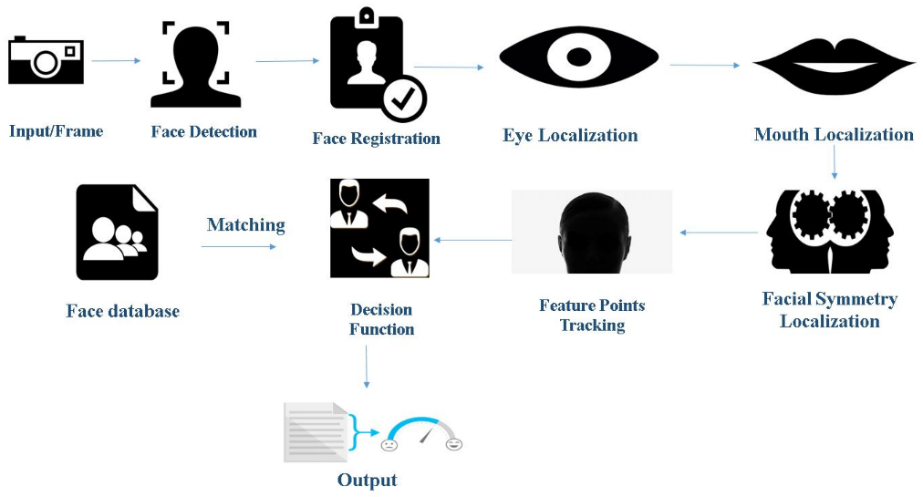
MODELLING
Wireframes
Modeling Process:
Data Collection
Preprocessing
Model Selection
Training
Evaluation
Optimization
Deployment
3/21/2024 Annual Review
9

Slide 10
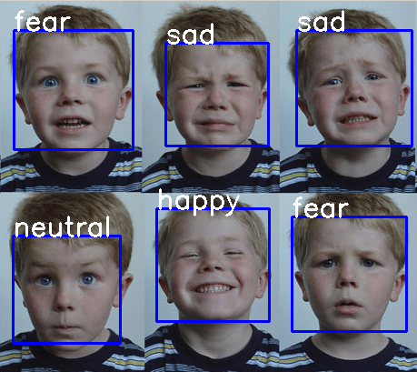
RESULTS
Output Images
Performance Metrics
Accuracy : 0.9111 or 91.11%
Precision : 0.8936 or 89.36%
Recall : 0.9333 or 93.33%
F1-score : 0.9127 or 91.27%
3/21/2024 Annual Review
10

